Slide 1

Annual Conference 2026
Useful information for attendees
Thursday 7th May 2026
Leonardo Royal London St Paul's, London

Slide 2
Sport Resolutions is a London based independent, not-for-profit, dispute resolution service for sport operating globally, offering arbitration, mediation, tribunal and expert opinion.

Slide 3
PROVISIONAL CONFERENCE AGENDA
 | 08:00 – 09:00 | WISLAW Breakfast
 | 08:45 – 09:15 | Registration / Breakfast
 | 09:15 – 09:20 | Welcome by Richard Harry
 | 09:20 – 09:30 | Welcome by Peter Crowther
L (1 hr) | 09:30 – 10:30 | 1st session
S (45 mins) | 10:30 – 11.15 | 2nd session
 | 11:15 – 11:45 | Coffee Break
L (1 hr 15 mins) | 11:45 – 13:00 | 3rd session
 | 13.00 – 14:30 | Lunch & Networking
L (1 hr) | 14:30 – 15:30 | 4th Session
S (45 mins) | 15:30 – 16:15 | 5th Session
 | 16:15 – 16:30 | Closing remarks by Audley Sheppard
 | 16:30 – 18:30 | Drinks Reception
*Please note that this is a provisional programme and may be changed slightly
in order to accommodate the needs of the audience/organisers/speakers

Slide 4
TRANSPORTATION
Airport arrival into London Heathrow:
Train- Heathrow Express or TFL rail service to London Paddington and then take the Circle or District Line Eastbound to Mansion House or Bakerloo Line Eastbound to Oxford Circus and change to the Central Line Eastbound to St Paul's.
London Underground- At Heathrow Terminal Stations take the Piccadilly Line Eastbound to Holborn Station and change to the Central Line Eastbound to St Paul's (1 hour). Alternatively, at Hatton Cross Station take the Piccadilly Line Eastbound to Gloucester Road and change to the Circle or District Line Eastbound to Mansion House.
(1-hour 5mins)
Taxi transfer- The journey time from Heathrow to the Hotel is around 1 hour and a round trip will cost around £100. An Uber from Heathrow to the hotel off-peak rate is £35-£45, prices may change depending on the time of travel.
Airport arrival into London Gatwick:
Train- Thameslink Train Northbound to City Thameslink, 5-minute walk to the hotel; or Gatwick Express to Victoria Station and then take the Circle or District Line Eastbound to Mansion House.
Taxi Transfer- The journey time from Gatwick to the Hotel is around 1 hour 30 mins and a round trip will cost around £150. An Uber from Gatwick to the hotel off-peak rate is around £65, prices may change depending on the time of travel.
For alternative routes and travel updates please visit Citymapper.

Slide 5
ACCOMODATION
Leonardo Royal London St Paul's - 10 Godliman St, London, EC4V 5AJ
Club Quarters Hotel - London, St. Paul's - 24 Ludgate Hill, London, EC4M 7DR
Crowne Plaza London, the City - 19 New Bridge St, London, EC4V 6DB
Premier Inn London Blackfriars (Fleet Street) hotel - 1-2 Dorset Rise, London, EC4Y 8EN
Apex Temple Court Hotel - 1-2, Serjeant's Inn, Temple, London, EC4Y 1AG
The Z Hotel City - 24 Fleet St, Temple, London, EC4Y 1AA
Hyde London - 15 Old Bailey, London, EC4M 7EF
Hilton Lost Property - 3-5 Ludgate Hill, London, EC4M 7AA
The Westin - 60 Upper Thames Street, London, EC4V 3AD, United Kingdom
We have corporate rate agreements with the Leonardo Royal, Apex Temple Court, Club Quarters, Hyde London, Hilton Lost Property and The Westin - subject to the hotel’s availability. Please contact the Sport Resolutions team (resolve@sportresolutions.com) should you wish to book one of these hotels.
For more accommodation options, please visit here.

Slide 6
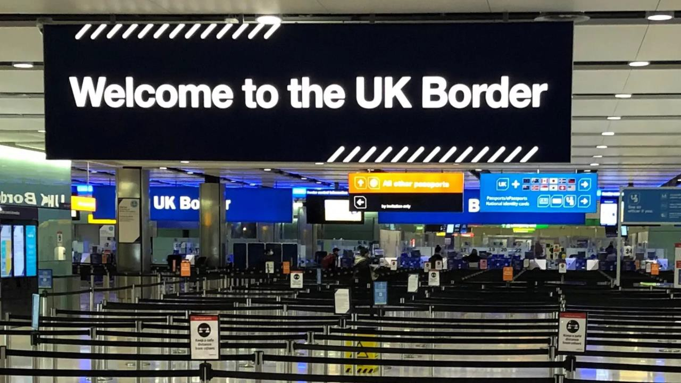
CRUCIAL INFORMATION
New entrance rules:
Europeans (excluding British and Irish citizens) will need a visa to enter the UK as of 2 April. This electronic travel authorisation (ETA) process has already started for American citizens.
An ETA costs £10 and permits multiple journeys to the UK for
stays of up to 6 months at a time over 2 years.
Anyone needing to apply for an ETA will be able to do so through a quick and simple process using the UK ETA app.
More information can be found here:
https://tinyurl.com/39vzpa94

Slide 7
OTHER DETAILS
CPD POINTS
CPD Members will collect 4.5 CPD Points for their attendance at our 2026 Annual Conference.
NEARBY ATTRACTIONS
St Paul’s Cathedral, River Thames, Museum of London, Borough Market, Tower Bridge. Please visit
VisitLondon.com for more attractions and further information.
For any questions or further information then please contact: resolve@sportresolutions.com

Slide 8


THANK YOU
@Sport_Res
Sport Resolutions
#SportRes2026

